Slide 1
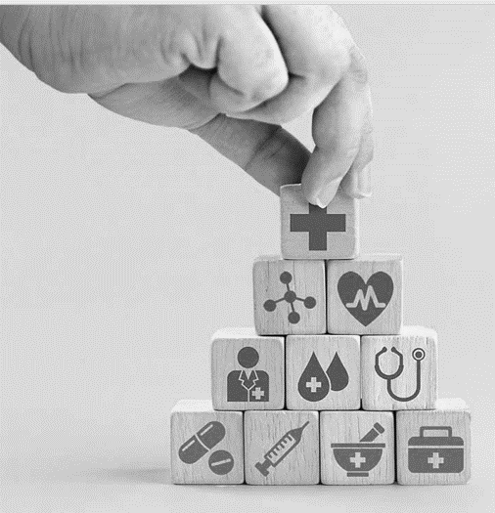
Pharmacists’ Role In Clinical Trials Safety
April 2024
423 PHRM
Dr. Nora Kalagi, MSc., PhD
Dr. Yasser Albogami, MPH, PhD
Clinical Pharmacy Department

Slide 2

What is Ethics in Research
Adhering to ethical, scientific, legal, and institutional standards in the conduct of research
Resnik DB. What is Ethics in Research and Why is it Important? [Internet]. NIH. 2015

Slide 3
Why is it Important?
Promote research aims: knowledge, truth, and avoiding errors
Promote values: trust, accountability, respect, and fairness
Promote moral/social values: human rights, animal welfare, public health, and safety
Ensure researchers can be held accountable to the public
Resnik DB. What is Ethics in Research and Why is it Important? [Internet]. NIH. 2015

Slide 4
Why is it Important?
Prevent / avoid crises to human, animal and the environment
Maximizing benefits and minimizing harms
Resnik DB. What is Ethics in Research and Why is it Important? [Internet]. NIH. 2015

Slide 5
Facts!
The history of research has not always been one of ethics and regulations
Medical research has been misused numerous times throughout history.

Slide 6
Ethical Issues In Research And Clinical Trials
Generally, pharmaceutical companies will invest more on research for drugs which are likely to be more lucrative in their sales.
Usually those diseases suffered by people in developed nations will be more attractive for the pharmaceutical companies.
For example, not much research is being carried out by pharmaceutical companies on drugs for AIDS as the vast majority of AIDS sufferers are from the third world such as those from the African continent.

Slide 7
Clinical Trials For New Drugs
In the study of a new chemical entity for the purpose of developing a medicine, clinical trials in humans are among the last steps to be carried out.
They will only be started after the chemical entity has gone through extensive preclinical studies and found to be fit and proper for human use and a dosage form for humans has been developed.
Clinical trials enable us to evaluate and assess the effectiveness of a new medicine in the treatment of a particular condition and also help to disclose possible side effects.

Slide 8
Clinical Trials For New Drugs
Before such a new medicine can be approved by the regulatory authorities, it must be proven to be efficacious and safe in the targeted patient population
Clinical trials will involve human subjects as volunteers so it is of paramount importance to ensure the safety and well-being of these volunteers and that all trials are conducted in accordance with global ethical principles.

Slide 9
Clinical Trials For New Drugs
Clinical trials deal with human beings so the human rights and dignity of people participating in clinical trials need to be protected.
Clinical trials follow a set of global accepted protocol in line with the requirements of the national health authority.
All clinical trials need to be approved by the national institutional ethics committee (IEC) in the country where they are carried out.

Slide 10
Clinical Trials For New Drugs
These global standards are not to be compromised. Clinical trials must be conducted in the same way all the time, no matter where in the world and by whom they are carried out.
Investigators must carefully select the subjects to participate to have the right profiles, obtain informed consent from each subject and take steps to ensure the well-being of the subjects throughout and after the trial.

Slide 11
Clinical Trials For New Drugs
Clinical trials must undergo independent scientific and ethical review and approval and are subject to audit by the national authorities during or after the trial.
All clinical trial results must be made publicly available.

Slide 12
Clinical Trials For New Drugs
Clinical trials should always be conducted according to global human rights declarations such as:
the Declaration of Helsinki
the Nuremberg code
the Belmont report
The International Conference on Harmonisation (ICH) guidelines for Good Clinical Practice.
The interest and well-being of the trial subjects should always prevail over the interest of science, society and commerce.
Clinical trials will only be conducted if they can be scientifically and medically justified and
potential benefits outweigh potential risks.

Slide 13
Clinical Trials For New Drugs
Children should only be included in a trial if there is no other research alternative.
Subjects participating in a clinical trial should, after the study has finished, be offered the best possible treatment, at the discretion of the investigator.
Everyone has to ensure transparency of clinical trials and clinical trial results for the good of humanity.

Slide 14
Pharmacists’ Role In Clinical Trials Safety

Slide 15

Clinical Trials Team
Investigator
Coordinator
Sponsor
Monitor
Contract Research Organization (CRO)
Clinical Research Associate (CRA)
Pharmacists
Nurses

Slide 16
Pharmacists’ Role In Clinical Trials Safety
Pharmacists play a multifaceted role in safeguarding the safety of participants and the integrity of clinical trials, thereby contributing to the advancement of medical knowledge and the development of new therapies.
Their involvement spans various stages of the trial process, including:
Protocol Development
Investigational Product Management
Drug Information
Medication Safety
Adherence Monitoring
Pharmacovigilance

Slide 17
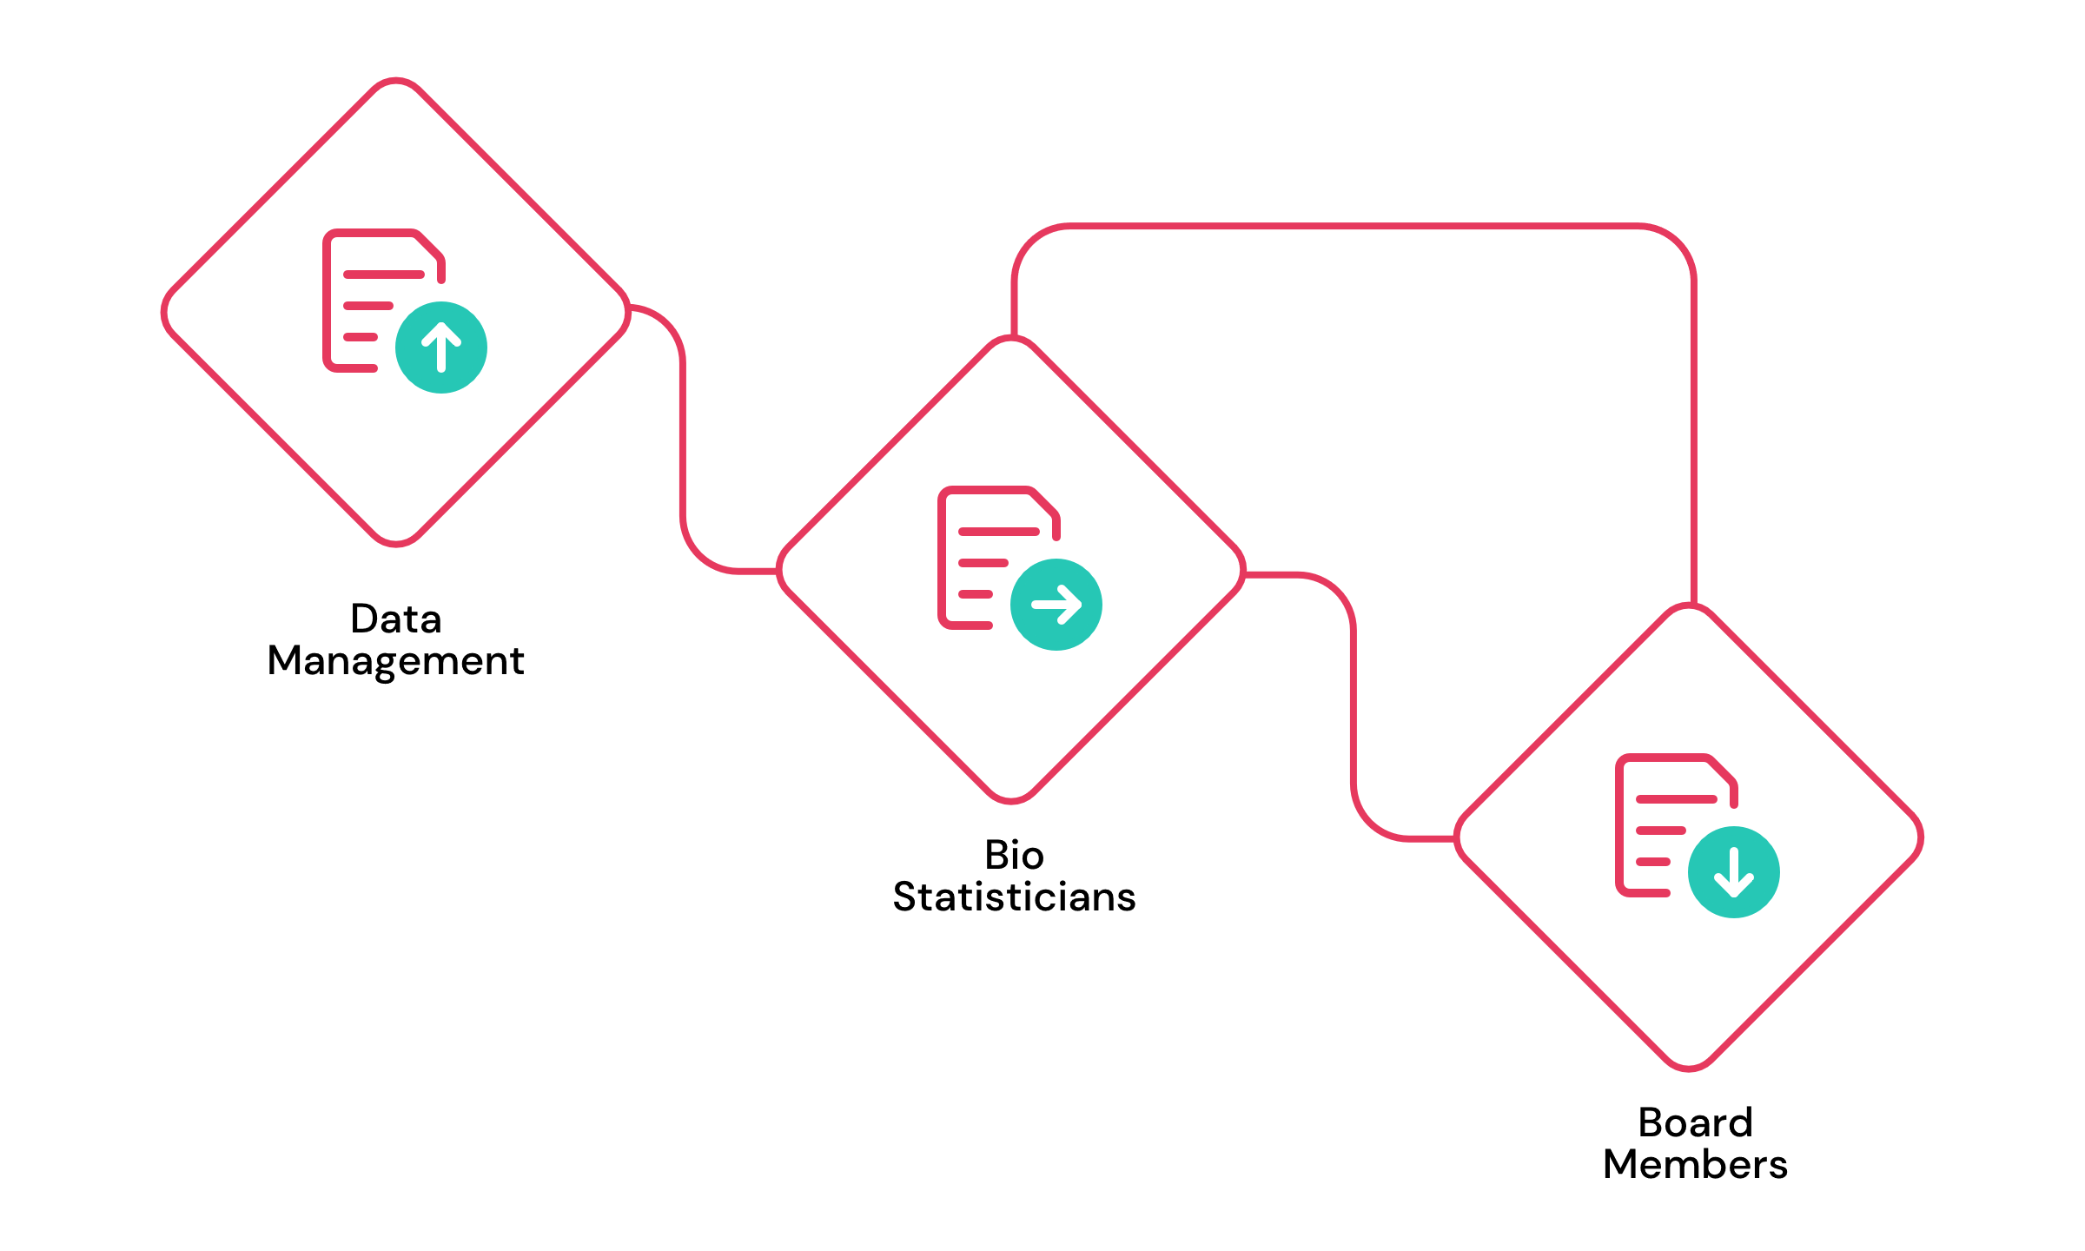
Pharmacists’ Role In Clinical Trials Safety
Also, pharmacists may contribute to the safety of clinical trials by serving as members of Data and Safety Monitoring Boards (DSMBs), an independent committees, typically comprised of experts in relevant fields, such as clinical research, biostatistics, ethics, and medicine, are responsible for monitoring the safety and efficacy of clinical trials.
As DSMB members, pharmacists review trial data, assess participant safety, and make recommendations regarding protocol modifications, participant enrolment, and trial continuation or termination based on safety concerns and data analysis.

Slide 18
key aspects of the pharmacist's role in clinical trial safety in DSMBs
Protocol Development and Review:
Investigational Product Management:
01
Providing expertise on drug therapy, pharmacology, and medication safety during the protocol development and review of clinical trials.
02
Overseeing the procurement, storage, handling, dispensing, and accountability of investigational products used in clinical trials.
They ensure that the protocol includes appropriate safety measures (eligibility criteria, dose escalation schedules, and monitoring procedures) and adheres to regulatory requirements and good clinical practice (GCP) guidelines.
They ensure that investigational products are stored and dispensed in compliance with regulatory standards and manufacturer specifications.

Slide 19
key aspects of the pharmacist's role in clinical trial safety
Data Analysis and Interpretation:
Adverse Event Monitoring and Reporting:
03
Contributing their expertise in data analysis and interpretation to DSMB meetings.
04
Monitoring and reporting adverse events (AEs) that occur during clinical trials. Conducting medication reconciliation to prevent potential interactions and adverse events.
They provide valuable insights into the clinical significance and implications of trial findings, guiding DSMB decision-making processes.
They also educate study participants and healthcare providers about potential side effects of investigational drugs and provide guidance on AE reporting.

Slide 20
key aspects of the pharmacist's role in clinical trial safety
Communication and Collaboration:
Pharmacovigilance Activities:
05
They Collaborate closely with the trial team, to ensure effective communication and collaboration throughout the clinical trial process.
06
Playing a key role in pharmacovigilance activities, via detecting, assessing, and preventing ADRs associated with investigational drugs
They provide input on safety-related matters, participate in interdisciplinary discussions, and contribute to the development of risk management plans and safety monitoring strategies
They collaborate with the study team and regulatory authorities to address safety concerns promptly and implement risk mitigation strategies as needed.
Notes:
Trial team includes healthcare professionals, study investigators, sponsors, and regulatory agencies

Slide 21
SUMMARY
Research ethics are a set of values and moral principles about how researchers should conduct themselves when dealing with participants, other researchers, colleagues, and society in general.
Objectives of Research Ethics is to ensure that research is conducted in a way that serves interests of individuals, groups and/or society.
Pharmacists play a crucial role in ensuring the safety, integrity, and success of clinical trials by actively engaging in various roles and activities (DSMBs membership) and contributing to the advancement of medical research and enhancing patient care outcomes

Slide 22

Any Questions?
CREDITS: This presentation template was created by Slidesgo, including icons by Flaticon, and infographics & images by Freepik.

Slide 23
Good Epidemiological Practices (GEP) and Good Pharmacovigilance Practices (GVP)
Ensuring Safety and Integrity in Drug Research and Surveillance
April 2024
ALLPPT.com _ Free PowerPoint Templates, Diagrams and Charts

Slide 24
Outline
Overview of GEP and GVP
Their Importance in drug research and surveillance
SFDA and ISPE guidelines
Integrating GEP and GVP
Challenges of implementation

Slide 25
Good Epidemiological Practices (GEP)
Refers to a set of principles and guidelines that govern the conduct of epidemiological studies aimed at investigating the distribution and determinants of health-related outcomes in human populations.
It aims to ensure the validity, reliability, and ethical conduct of epidemiological research, ultimately contributing to evidence-based decision-making in healthcare,
by emphasizing transparency, methodological rigor, and adherence to regulatory standards in epidemiological investigations.

Slide 26
Good Epidemiological Practices (GEP)
GEP provides a framework for designing, conducting, analyzing, and reporting epidemiological research studies, including cohort studies, case-control studies, and surveillance studies.
The Saudi Food and Drug Authority (SFDA) and International Society for Pharmacoepidemiology (ISPE) has established guidelines to promote the adoption of GEP principles in epidemiological research ensuring the quality and credibility of study findings.

Slide 27
SFDA Guidelines on Good Epidemiological Practices (GEP)
The SFDA Guidelines on GEP aim to establish standards and principles for the conduct of epidemiological research in Saudi Arabia.
The guidelines apply to all epidemiological studies conducted within the country's jurisdiction, including observational studies, cohort studies, case-control studies, and surveillance studies.
The guidelines emphasize the importance of selecting appropriate study designs and methodologies to address specific research questions.
Researchers are encouraged to employ rigorous methods for data collection, analysis, and interpretation, ensuring the validity and reliability of study findings.

Slide 28

SFDA GEP Principles
THE key PRINCIPLES OF GEP
Robust data management systems
Quality assurance measures
Ethical principles and guidelines
Regulatory Compliance
Researchers must ensure the protection of the participants rights, privacy, and confidentiality
should be established to ensure the accuracy, completeness, and integrity of study data
should be implemented to maintain the highest standards of data quality and reliability.
Researchers must obtain necessary approvals and permits from regulatory authorities before initiating epidemiological studies.
Notes:
including regular audits and validation procedures,

Slide 29
SFDA GEP Principles
THE key PRINCIPLES OF GEP
Reporting and Dissemination
Researchers are required to prepare comprehensive reports of their study findings, adhering to standardized reporting guidelines and formats.
Study results should be disseminated through peer-reviewed publications, conference presentations, and other appropriate channels to facilitate knowledge exchange and dissemination.
Notes:
including regular audits and validation procedures,

Slide 30
The GEP address the following areas:
Protocol Development
Responsibilities, Personnel, Facilities, Resource Commitment, and Contractors
Study Conduct
Communication
Adverse Event Reporting
Archiving
https://www.pharmacoepi.org/resources/policies/guidelines-08027/

Slide 31
Each study should have a written protocol. A protocol should be drafted as one of the first steps in any research project, and the protocol should be amended or updated as needed throughout the course of the study.
The organization(s) and individual(s) conducting and sponsoring the research shall be fully responsible for the research. The relationship, roles, and responsibilities of the organizations and/or individuals conducting and sponsoring the study should be described.
The PI shall be responsible for the overall content of the research project, including the day-to-day conduct of the study, interpretation of the study data, and preparation and publication of the final report.
PI: principal investigator
https://www.pharmacoepi.org/resources/policies/guidelines-08027/

Slide 32
Each organization and its advisory board shall predetermine procedures under which communications of the intent, conduct, results, and interpretation of an epidemiologic study will occur.
Aggregate analysis of electronic healthcare databases may identify an unexpected increase in risk associated with a particular exposure
Secure archives must be maintained for the orderly storage and expedient retrieval of all study related materials (protocol, final report of study, all source data, etc.)
https://www.pharmacoepi.org/resources/policies/guidelines-08027/

Slide 33
Good Pharmacovigilance Practices (GVP)
GVP encompass a set of principles and guidelines designed to ensure the systematic monitoring, assessment, and management of the safety profile of medicinal products throughout their lifecycle.
Its primary objective is to protect public health by minimizing the risks associated with the use of pharmaceutical products while maximizing their therapeutic benefits.

Slide 34
Good Pharmacovigilance Practices (GVP)
GVP plays a crucial role in pharmacovigilance and drug safety by establishing standardized processes and procedures for the detection, assessment, understanding, and prevention of adverse drug reactions (ADRs) and other safety issues.
Pharmacists, as key stakeholders in pharmacovigilance, are responsible for implementing GVP principles in their practice settings to ensure the safe and effective use of medications

Slide 35
GVP Key Principles and Guidelines
GVP is based on several key principles, including:
Proactive risk identification
Effective risk communication
Continuous monitoring of safety data
Prompt implementation of risk minimization measures.
The guidelines outline specific requirements for pharmacovigilance activities, such as adverse event reporting, signal detection, risk management planning, and periodic safety update reporting.

Slide 36
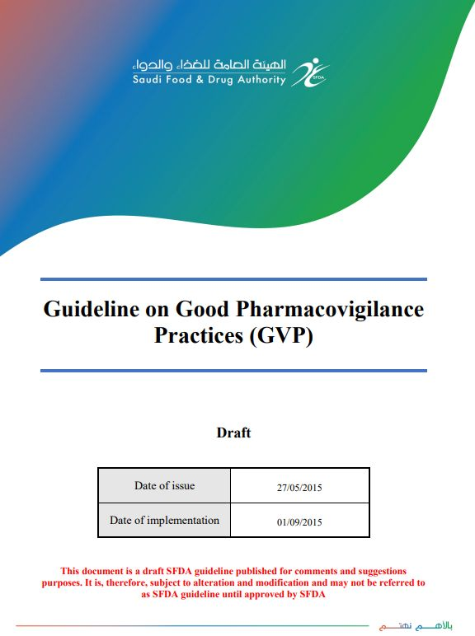
SFDA guidelines for GVP
The SFDA provides comprehensive guidelines for Good Pharmacovigilance Practices to ensure the safety and efficacy of medicinal products in Saudi Arabia.
These guidelines outline the principles, requirements, and procedures that pharmaceutical companies, healthcare professionals, and regulatory authorities must follow to monitor and manage the safety of medicines throughout their lifecycle.

Slide 37



SFDA GVP guidelines
key elements of the SFDA GVP guidelines:
Pharmacovigilance System Master File (PSMF)
Qualified Person for Pharmacovigilance (QPPV)
Local Implementation
Quality Management System (QMS)
Submission Requirements

Slide 38
SFDA GVP guidelines
Pharmacovigilance System Master File (PSMF):
Each Marketing Authorization Holder (MAH) must maintain a PSMF that details their pharmacovigilance system.
This file should include information on the pharmacovigilance activities, organizational structure, and roles and responsibilities related to pharmacovigilance.
It should be accessible and provided to the SFDA upon request.
Qualified Person for Pharmacovigilance (QPPV):
The guidelines require a QPPV to oversee the pharmacovigilance system.
This individual must have sufficient qualifications and authority to ensure compliance with pharmacovigilance requirements and must reside in Saudi Arabia.

Slide 39
SFDA GVP guidelines
Local Implementation:
Foreign pharmaceutical companies must have a local pharmacovigilance system in place, which can be managed internally or through outsourcing to local service providers approved by the SFDA.
Quality Management System (QMS):
MAHs must establish a QMS that supports pharmacovigilance activities, ensuring compliance with standard operating procedures, document control, and corrective and preventive actions.

Slide 40
SFDA GVP guidelines
Submission Requirements:
At drug registration, MAHs need to submit detailed pharmacovigilance documentation, including the PSMF, risk management plans, and details of the QPPV.
These guidelines are designed to protect public health by ensuring that all parties involved in the distribution and management of medicinal products maintain high safety standards through effective pharmacovigilance practices.

Slide 41
How to Integrate between GEP and GVP?
The integration of these practices a crucial aspect of pharmacovigilance, as it combines the strengths of epidemiological methods with
the regulatory frameworks designed to ensure drug safety and efficacy.

Slide 42
How to Integrate between GEP and GVP?
 | GEP | GVP
Practice Goals | Both aim to monitor and evaluate the effects of drugs on populations, ensuring public health safety by identifying, assessing, and preventing adverse events and other drug-related problems.
Data Analysis and Interpretation | GEP provides robust methodologies for the design, conduct, and interpretation of studies, which are essential for the evidence-based decision-making process in GVP
Risk Assessment | Contributes to the risk assessment process by providing data about the incidence and prevalence of adverse events | Uses the data obtained by GEP to implement risk management plans
Signal Detection | GEP methodologies enhance the detection of safety signals from real-world data | GVP then investigates through pharmacovigilance activities

Slide 43
Challenges of implementing GEP and GVP
Data Quality and Standardization:
Integrating data from various sources can be challenging due to differences in quality, format, and completeness.
Regulatory Variability:
Differences in pharmacovigilance regulations across countries can complicate the application of standardized epidemiological methods.

Slide 44
Challenges of implementing GEP and GVP
Technological Barriers:
The integration of new technologies like big data analytics and artificial intelligence into traditional pharmacovigilance systems can be difficult.
Resource Limitations:
Both fields require specialized knowledge and skills, and there may be a shortage of trained professionals to implement integrated approaches effectively.

Slide 45
The successful integration of GEP and GVP can enhance the efficiency and effectiveness of pharmacovigilance systems, leading to better health outcomes and improved public health safety.
SUMMARY

Slide 46


